Slide 1
TinyMvvm for Xamarin.Forms
Daniel Hindrikes
@hindrikes
Notes:
Hi and welcome!

Slide 2

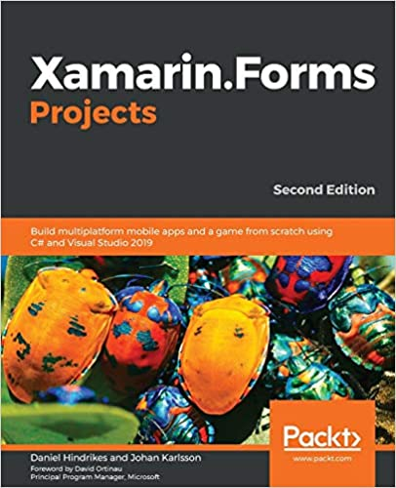


Quote slide
Daniel Hindrikes
Developer and Architect for mobile- and cloud solutions
tretton37 - Borlänge
Co-author of Xamarin.Forms Projects
Podcaster
Twitter: @hindrikes
Blog: https://danielhindrikes.se

Slide 3
Why I created TinyMvvm?
Navigation abstraction
Reuse of code
Notes:
Once upon a time I had an idea about that I don’t needed any MVVM framework. Because Xamarin.Forms has built-in support for MVVM.
But after a while I realize that is it pretty nice to have ViewModels that don’t have any dependencies to Xamarin.Forms. Because I can reuse them if I build an application with another UI framework. And now it will also be easier to convert my apps to MAUI, because I don’t have any references to Xamarin.Forms in the VIewModel layer.
I also realized that I tend to copy-paste or write the same code over and over again for every app that I started.
So I first create a library called TinyNavigationHelper that was the navigation abstraction. Later I baked that into to a new library that became TinyMvvm.
Today I will first talk about how to use TinyMvvm and after that I will dive in to how TinyMvvm is working under the hood.

Slide 4
Features of TinyMvvm
IOC helper/resolver
Navigation helper
Base class for views
Base class for view models
ICommand implementation
Notes:
IoC can be used by developers, but it is also used internal by TinyMvvm.
0

Slide 5
Get started – NuGet packages
For Xamarin.Forms projects:
TinyMvvm.Forms
TinyMvvm.Autofac or TinyMvvm.TinyIoC
For Core projects:
TinyMvvm
Notes:
IoC can be used by developers, but it is also used internal by TinyMvvm.
0

Slide 6
Demo

Slide 7
For docs, samples
and source code, go to:
https://github.com/TinyStuff/TinyMvvm

Slide 8
Quote slide
Daniel Hindrikes
twitter: @hindrikes
twitch: https://www.twitch.tv/danielhindrikes
linkedIn: /in/daniel-hindrikes
blog: https://danielhindrikes.se

